Slide 1
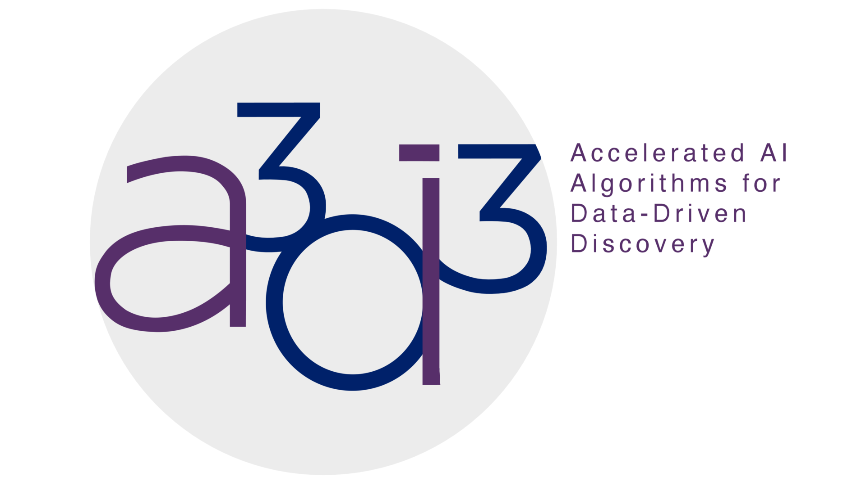

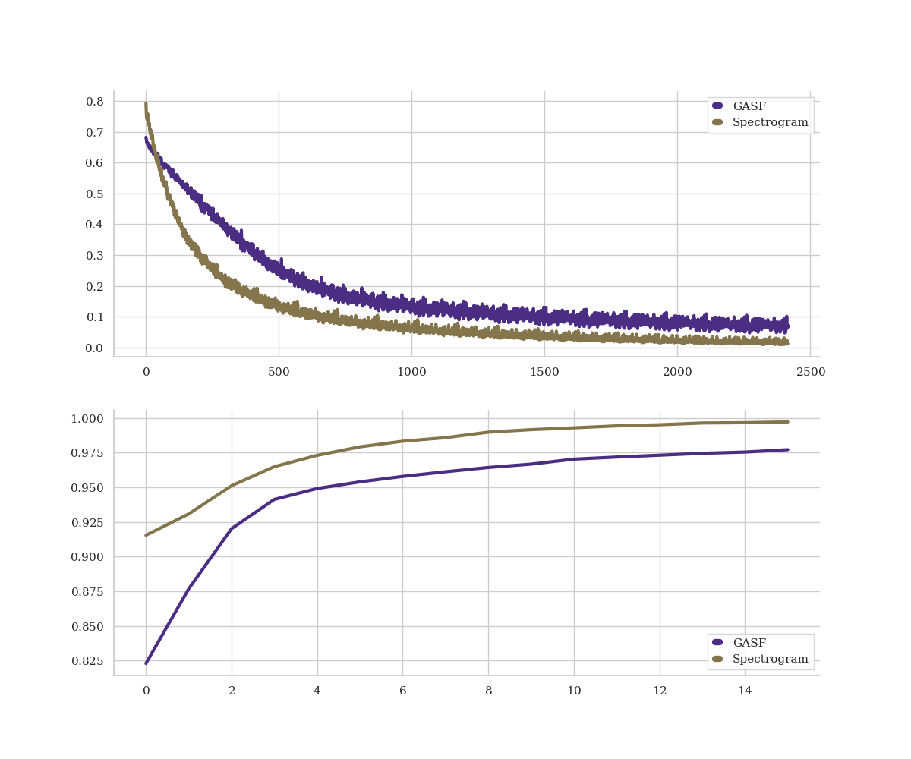
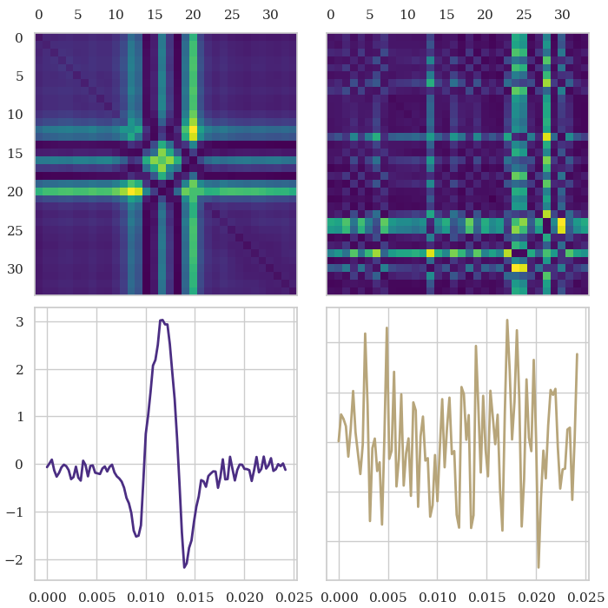
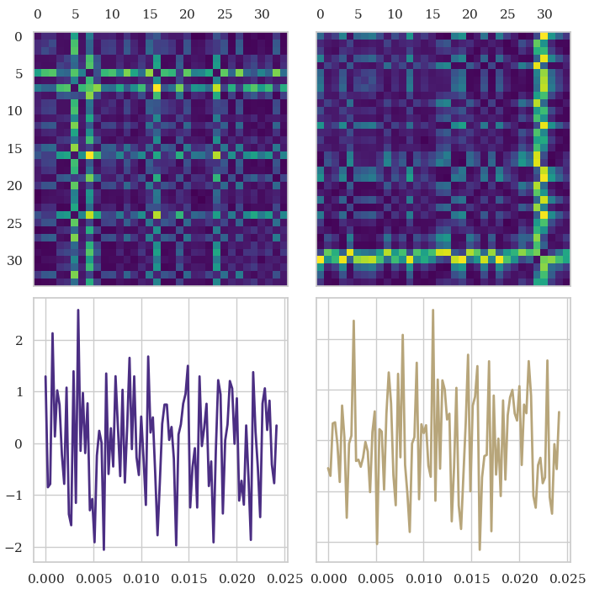
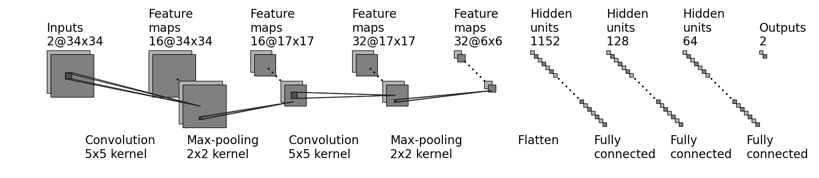
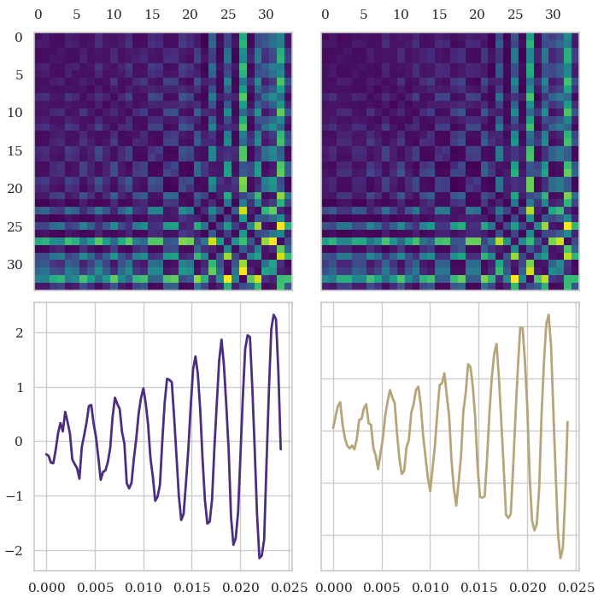
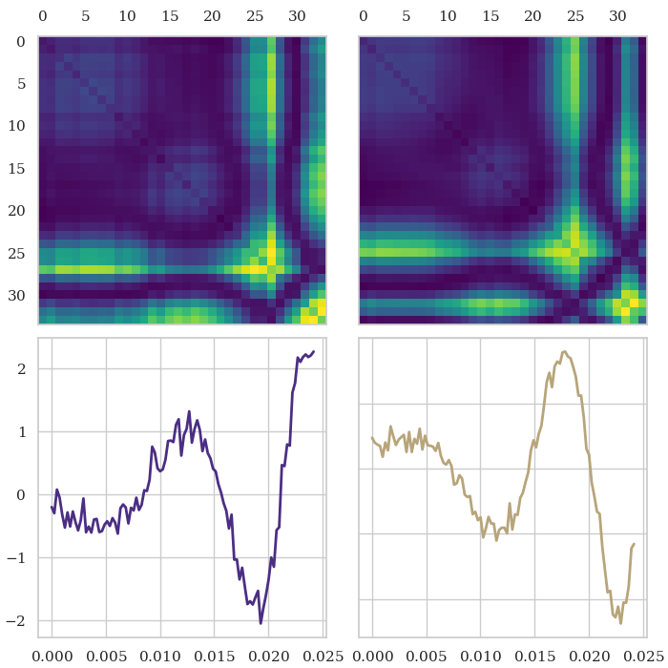
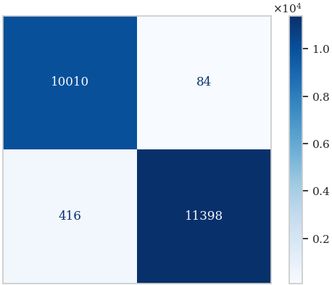
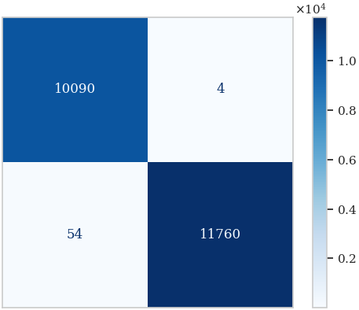
Unraveling Gravitational Ripples: Neural Network Classification
Daniel Fredin¹, Cole Welch¹
¹Department of Physics, University of Washington
Special thanks to OAC award #2117997 for funding A3D3
INTRODUCTION
QUICK FACTS ABOUT OUR CNN MODEL
> 97% testing accuracy
Data split of 70% training, 15% validation, and 15% testing
Dataset contains a total of 146045 simulated gravitational wave time series data samples
Applied Gramian Angular Summation Field (GASF) algorithms to encode gravitational wave data as 2D images for classification
Neural network contains 2 convolutional / max-pooling layers followed by 3 fully connected layers and an output
CONCLUSION
Dataset source: Glitch dataset is simulated data that originates from the Laser Interferometer Gravitational-Wave Observatory (LIGO).
Dataset categories: Consists of four distinct data categories - Glitch, Background, Sine-Gaussian (SG), and Binary Black Hole (BBH).
Objective: Develop a binary classifier to identify signals as either Glitch/Background or Sine-Gaussian/Binary Black Hole using GASF method vs FFT Spectrogram.
Objective: Analyzed the potential of CNNs for classifying gravitational wave strain data as background noise/glitches or transient sine-gaussian/binary black hole merger signals utilizing the GASF method. Performance: Exceeded the anticipated 85% accuracy by attaining an impressive testing accuracy of > 97%, slightly less than FFT’s 99%.
Further exploration: Examining the efficacy of the GASF technique in GW detection by using a new dataset with SNR ~ 4 for analysis.
METHODOLOGY
 | Training Loss and Validation Accuracy
Training Loss
Validation Accuracy
 | Epochs
Image Conversion: Convert time series data to 2D images using Gramian Angular Summation Fields (GASFs) from the pyts library.
Image size: GASF images are 34x34 pixels for a balance between performance and accuracy.
Data splitting: Split data into training (70%, 102227 images), testing (15%, 21910 images), and validation (15%, 21908 images) sets.
CNN architecture:
Two convolution layers with batch normalization and max pooling layers applied after each convolution layer, three subsequent fully connected layers and an output layer
 | Glitch
 | Detector 1 | Detector 2
 | Pixels | Pixels
Strain
Strain
 | Time (s) | Time (s)
 | Background
 | Detector 1 | Detector 2
 | Pixels | Pixels
Strain
Strain
 | Time (s) | Time (s)
Iterations
 | Sine-Gaussian
 | Detector 1 | Detector 2
 | Pixels | Pixels
Strain
Strain
 | Time (s) | Time (s)
 | Binary Black Hole
 | Detector 1 | Detector 2
 | Pixels | Pixels
Strain
Strain
 | Time (s) | Time (s)
The training loss of the CNN plotted against the number of iterations (top) and the validation accuracy of the CNN plotted against the number of elapsed epochs (bottom); GASF method (purple) and FFT spectrogram (gold).
Basic structure of our convolutional neural network (CNN).
Confusion Matrix |  | Confusion Matrix
 |  | GASF | Detector 2 |  |  |  |  | Spectrogram
Truth | Background |  |  |  |  | Truth | Background
 | Signal |  |  |  |  |  | Signal
 |  | Background | Signal |  |  |  |  | Background | Signal
 |  | Predicted |  |  |  |  |  | Predicted
DATA ANALYSIS
Model output: Probability predictions of images for background or signal compared to ground truth targets with Softmax function.
Testing and accuracy: Tested trained model against a separate testing dataset, achieved an overall accuracy of > 97%.
Misclassification patterns: Model tends to misclassify when detectors have conflicting data.
Possible flaws: Confusion may arise from contradictory signals between detectors or flaws in observatory data capture.
An example of the four signal categories derived from the time series data, along with their corresponding GASF images for both Detector 1 and Detector 2.
The confusion matrix for the GASF method (left) compared with the confusion matrix for the FFT spectrogram (right).
GRAMIAN ANGULAR SUMMATION FIELDS (GASF)
RESULTS
REFERENCES
Testing accuracy: CNN model demonstrated an exceptional accuracy of 97.72% when evaluated on the testing dataset.
Comparison with FFT: Achieved slightly less accuracy than FFT spectrograms which achieved 99.69% accuracy.
Comparison with literature: Similar CNN architectures in the literature achieved higher accuracies, such as 99% (Fernandes et al., 2018).
Dataset differences: Our dataset consisted of separate time series for gravitational wave signal data and noise data, while other works had to apply more complex noise filtering methods.
[1] Z. Wang and T. Oates. Encoding Time Series as Images for Visual Inspection and Classification Using Tiled Convolutional Neural Networks. In The Twenty-Ninth AAAI Conference on Artificial Intelligence. (AAAI), January 2015.
[2] T. S. Fernandes, et al. Convolutional Neural Networks for the classification of glitches in gravitational-wave data streams, arXiv:2303.13917v1 [gr-qc], March 2023.
Definition: Method for visualizing time series data in a two-dimensional image format.
Conversion: Converts time series into a symmetric matrix which represents the pairwise angles between points in the time series.
Application: Provides visual representation of complex temporal patterns which is useful for tasks like classification of time series data.
ACKNOWLEDGEMENTS
The authors gratefully acknowledge the simulated dataset provided by Dr. Andy Chen, National Yang Ming Chiao Tung University, the opportunity to perform this research facilitated by Prof. Hsu and the UW course, PHYS 417: Neural Network Methods in Engineering and Physical Sciences, and A3D3 supported by the National Science Foundation under Cooperative Agreement OAC-2117997.

